Slide 1


A review on HAVOK analysis for non-linear systems
Allegri Luca
De Masi Michele
Grilli Alessandro
Sbarbati Riccardo
Università degli studi di Padova
Physics of Data
Laboratory of Computational Physics
A.A. 2021/2022

Slide 2
Introduction
HAVOK analysis for chaotic system:
HAVOK critical issues
Application of Neural Network
Different integrable systems where HAVOK has a good response:
Open questions
Linearization of non-linear systems Prediction of the dynamic behaviour of a system
Lorenz attractor Financial system Magnetic Pendulum

Slide 3

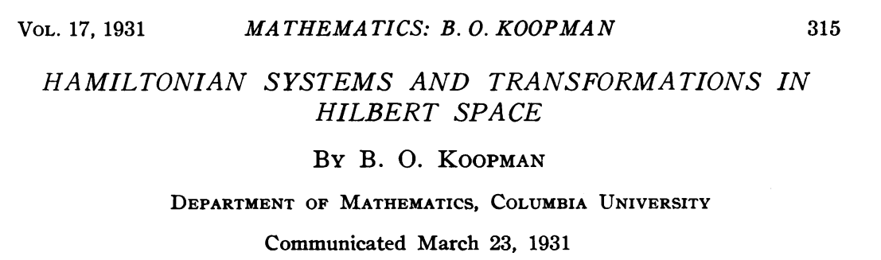
HAVOK - Hankel Alternative View Of Koopman
A universal, data-driven decomposition of chaos as an intermittently forced linear system.
Combination of delay embedding and Koopman theory.

Slide 4
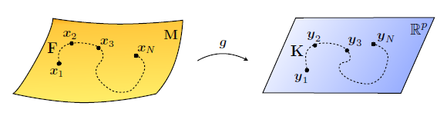
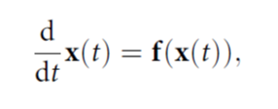

Linear representation of non-linear dynamics
Transformation of a non-linear dynamic equation in the coordinate space in a linear equation in an infinite dimensional Hilbert space.

Slide 5
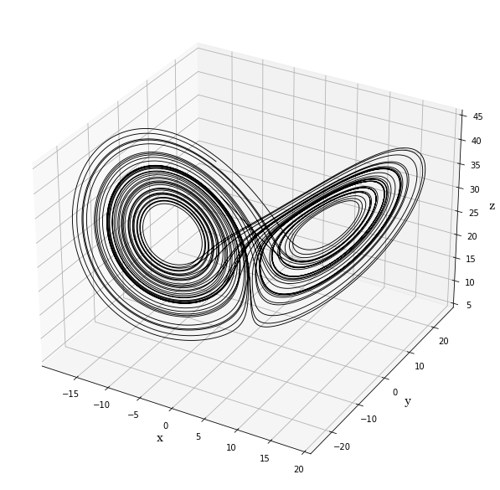
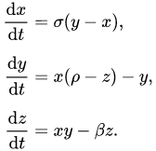
HAVOK Analysis
The most common chaotic system: Lorenz attractor
β = 8/3 σ = 10 ρ = 28

Slide 6
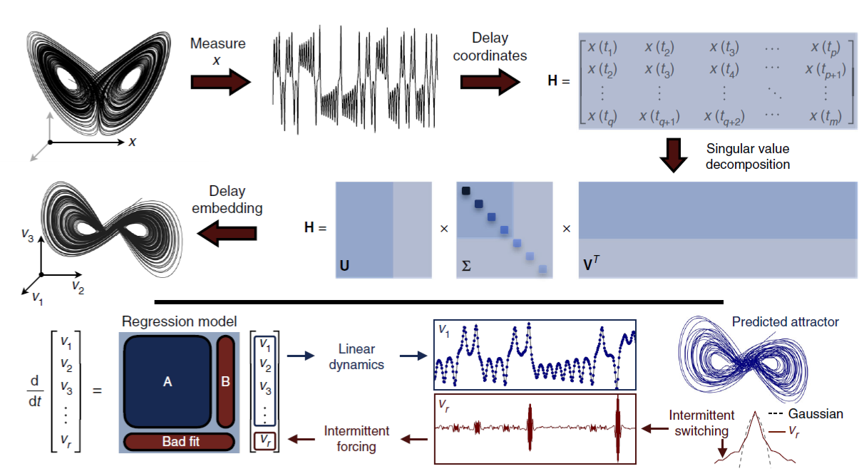
HAVOK Analysis
From the 3D representation of the system we extract a time series from the most meaningful coordinate.

Slide 7
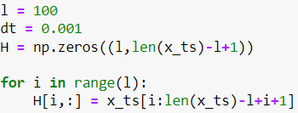
HAVOK Analysis
From the 3D representation of the system we extract a time series from the most meaningful coordinate.
We set the time step dt and the dimension of a sliding window l to build a Hankel matrix from the time series.

Slide 8

HAVOK Analysis
Singular Value Decomposition is applied and the first r eigenvalues are selected.

Slide 9
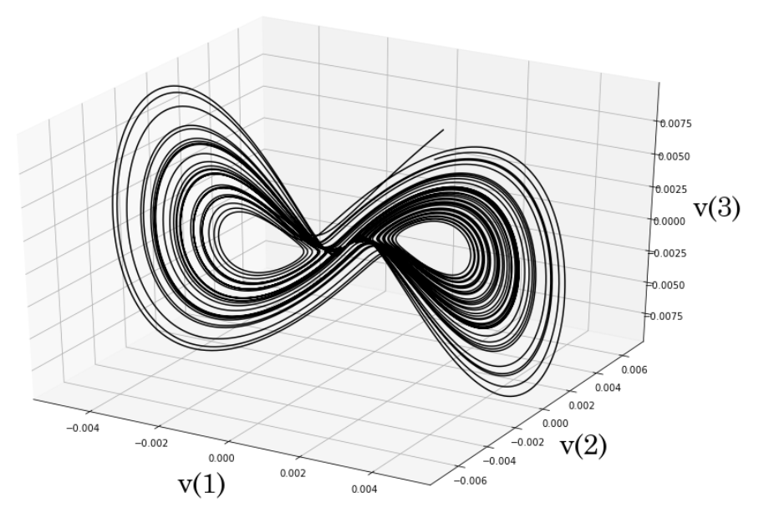
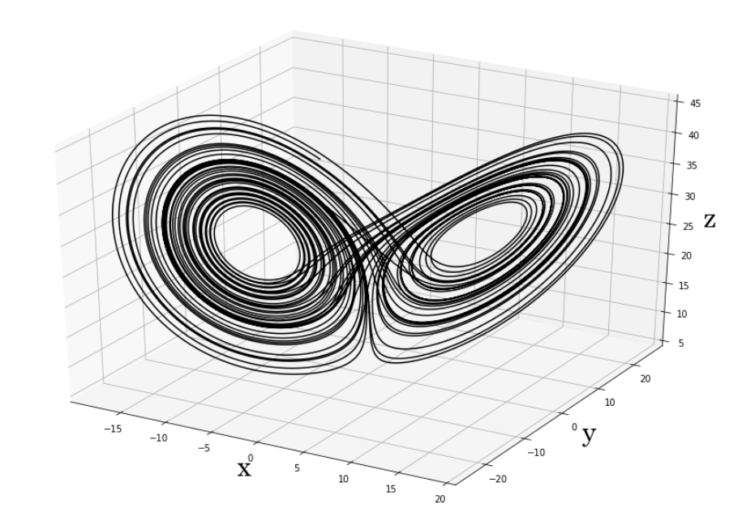
HAVOK Analysis
The first three columns of V create an embedded attractor.
Original Lorenz attractor
Embedded attractor

Slide 10
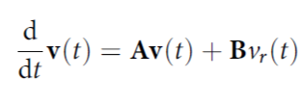
HAVOK Analysis
These r eigenvectors are used to train a linear model with a sparse regression.
The first r-1 vectors are the linear coordinates of our model, v_{r} is a forcing term that influences the dynamics.

Slide 11
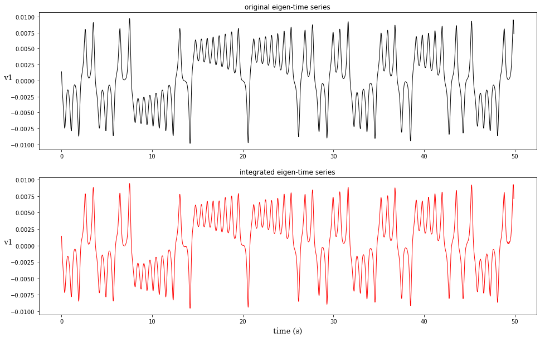
HAVOK Analysis

Slide 12
HAVOK Analysis
Original Lorenz system
Embedded attractor
Integrated system

Slide 13
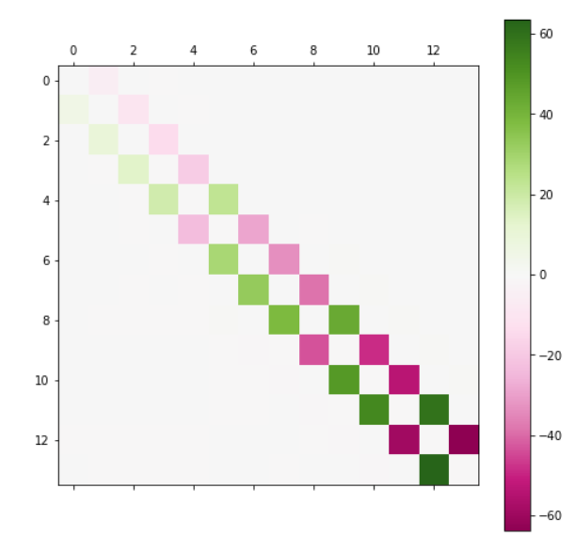
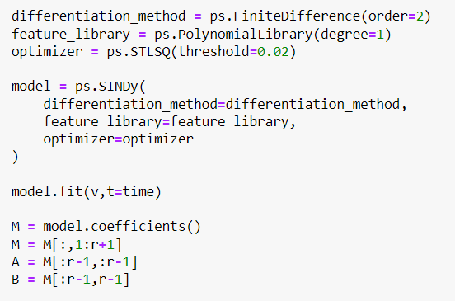
HAVOK Analysis
A curious pattern is created.
A

Slide 15
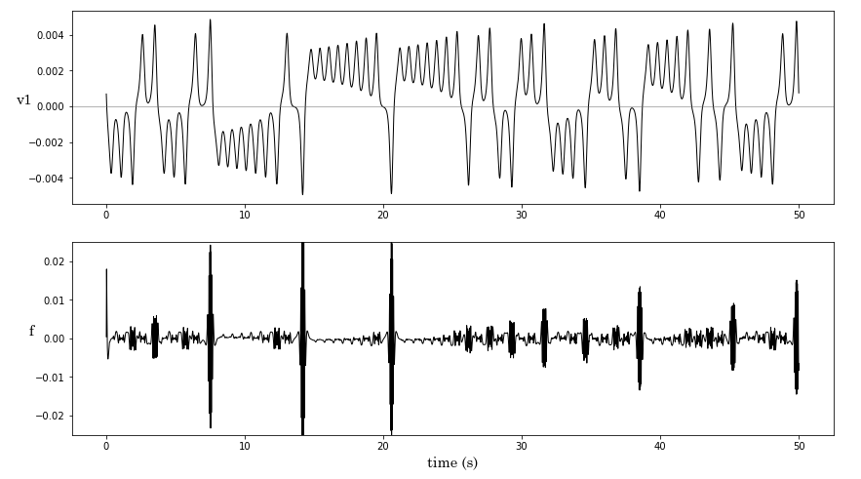
Role of the forcing term
There seems to be a correlation between peaks of the forcing term f and the chaotic switches of the system.

Slide 16
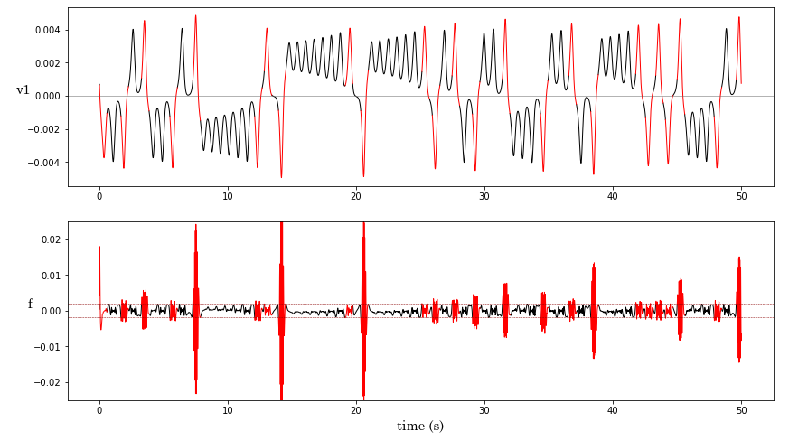
Role of the forcing term
This is verified by setting a threshold on f.

Slide 17
Training model for online prediction
The knowledge of the forcing term would allow to predict the lobe switching for new incoming data.
But we cannot have access to this information in advance.
High peaks of v_{r} anticipate the lobe switching.
Is it possible to gather this information before the actual change of the system?

Slide 18
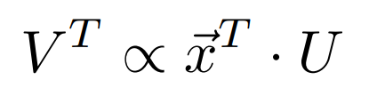
Training model for online prediction
v_{r} comes from applying SVD on the Hankel matrix, but this is not doable for real time computation.
However, we can compute U from the SVD of a restricted dataset and then infer the subsequent principal coordinates point by point with a convolution:
The delay of this operation depends on the length of the sliding window and on the size of the timestep.

Slide 19
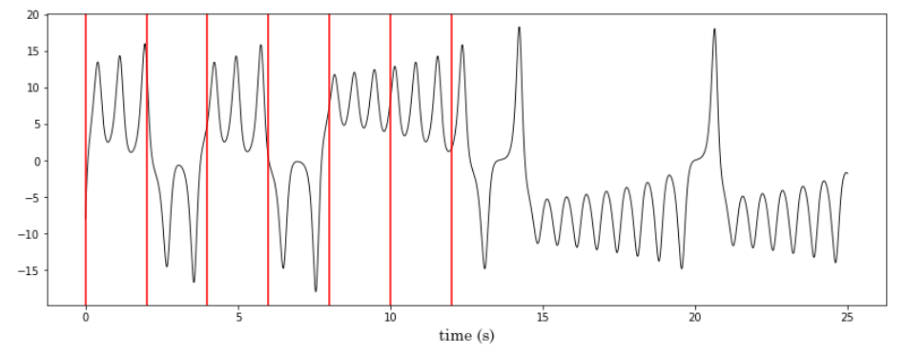
Critical issues – l & dt parameter estimation
When building the Hankel matrix, it is important to choose an appropriate size for the sliding window, such that it can represent the characteristics of the system without losing too much information.
The sampling timestep should not be wider than the typical period.
Excessively large sampling window does not represent the system!

Slide 20
Critical issues – l & dt parameter estimation
The parameter choice must be done by hand, such that the model does not diverge too early but does not have too much intrinsic delay in the computation of the forcing term.
For the Lorenz system:
l = 100
dt = 0.001s
This allows a good model accuracy and equals to a delay of 0.1s for the online prediction, which is shorter than the period of a single loop (around 0.7s).

Slide 21
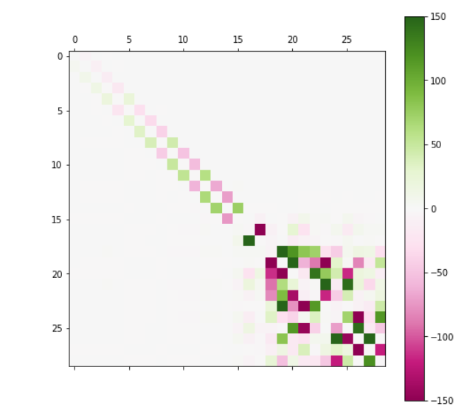
Critical issues - r parameter estimation
The number of principal vectors chosen strongly affects the efficiency of the model and is an operation that must be done by hand in a backward process, based on the pattern of matrix A.

Slide 22
Critical issues - r parameter estimation
The number of principal vectors chosen strongly affects the efficiency of the model and is an operation that must be done by hand in a backward process, based on the pattern of matrix A.
For the Lorenz attractor, the maximum number of principal vectors is r = 15

Slide 23
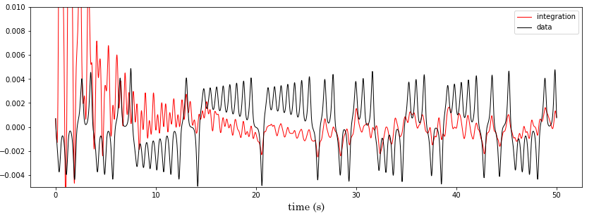
Critical issues - r parameter estimation
The number of principal vectors chosen strongly affects the efficiency of the model and is an operation that must be done by hand in a backward process, based on the pattern of matrix A.
Increasing too much the dimensionality leads to a model that does not reproduce the dynamics of the system.

Slide 24
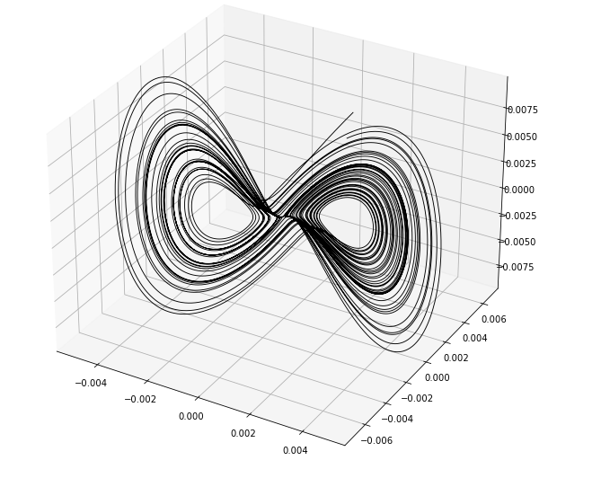
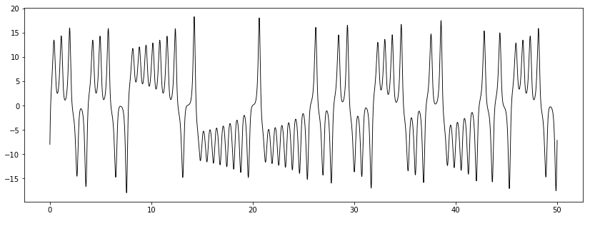
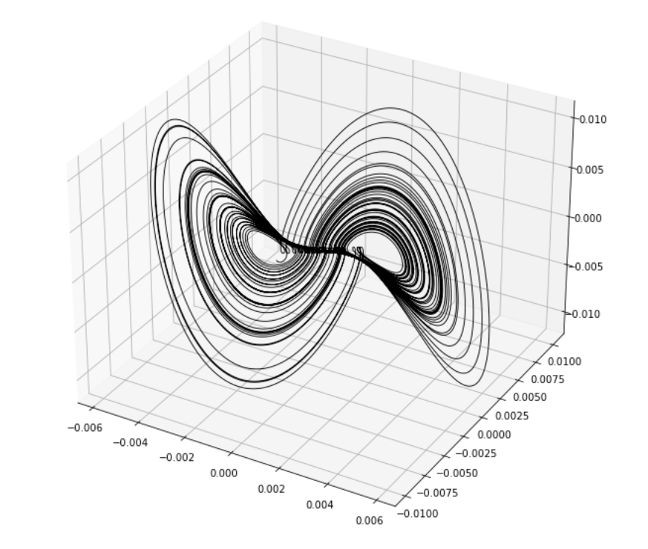
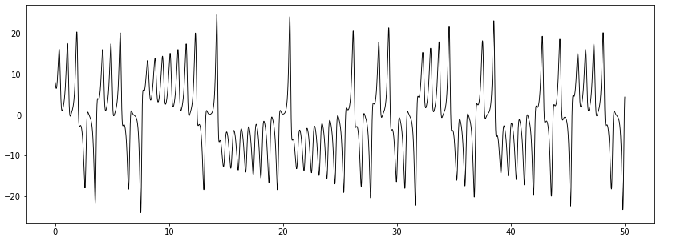
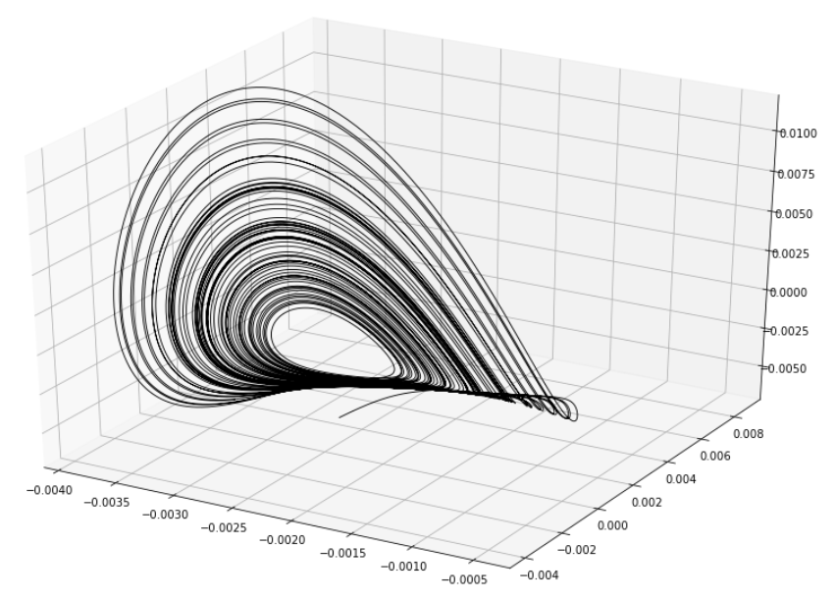
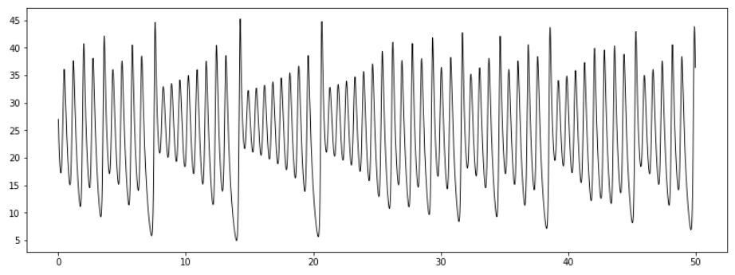
Critical issues – coherent time series
For a system with dimension > 1, it is important to look at the axis projection that gives you the most interesting time series, information-wise.
X
Y
Z

Slide 25
Critical issues - behaviour prediction
By now, the prediction of the lobe switching is done setting a threshold on the forcing term.
The accuracy of this method for the Lorenz system is around 99%, with a false positive rate of about 2.5%.
But the Lorenz system is one of the simplest examples of chaotic dynamics.
This percentages may not necessarily be true for other more complex chaotic models.

Slide 26
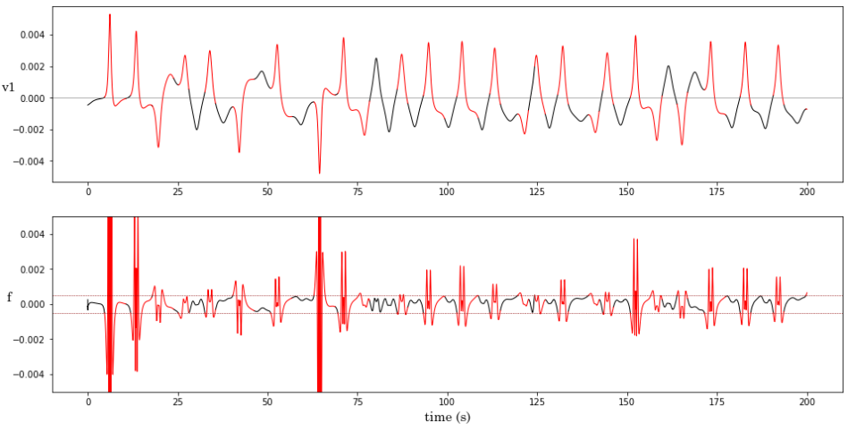
Critical issues - behaviour prediction
Sometimes the effect of the forcing term activation is not straightforward.
Chaotic model for a financial system.
l = 100
dt = 0.001
r = 9

Slide 27
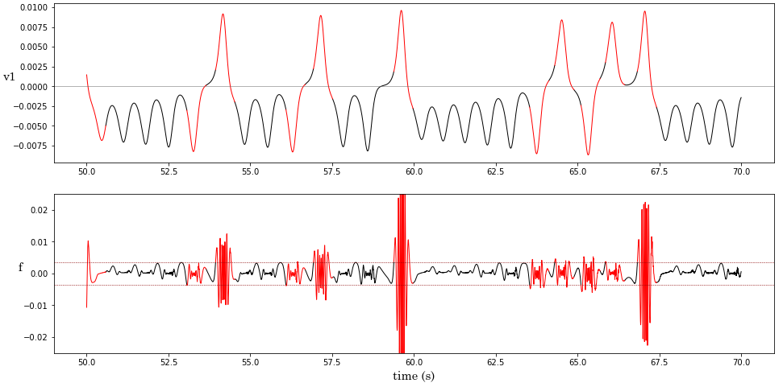
Critical issues - behaviour prediction
Even the Lorenz system shows ambiguity in some instances, suggesting that the lobe switching must not depend only on the forcing term.

Slide 28
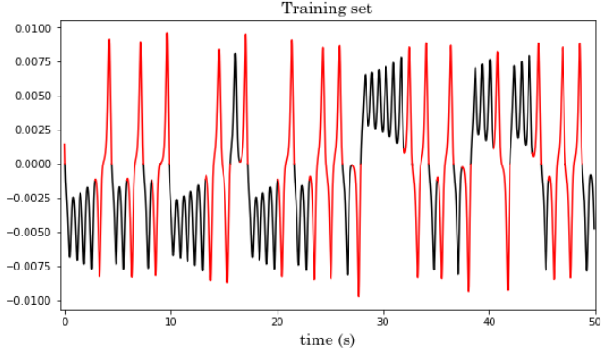
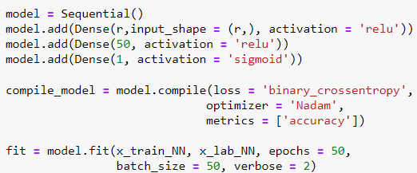
Neural Network for lobe switching
A Neural Network is implemented to avoid the threshold issues.
The evaluated output of the NN, gives the following results:

Slide 29
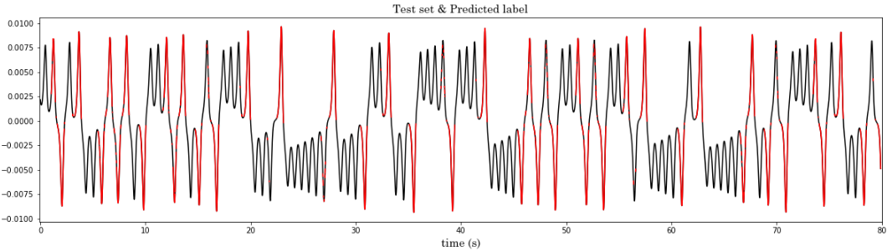
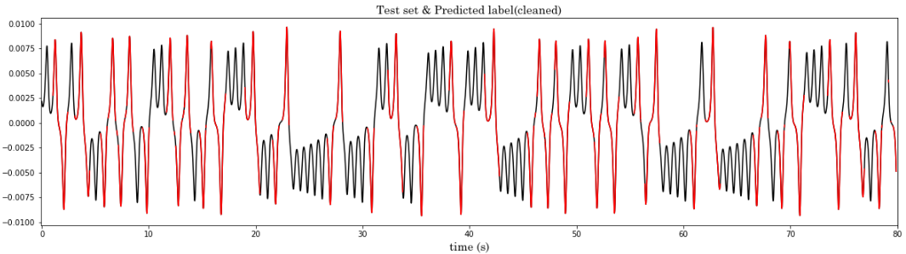
NN: prediction of the lobe switching

Slide 30
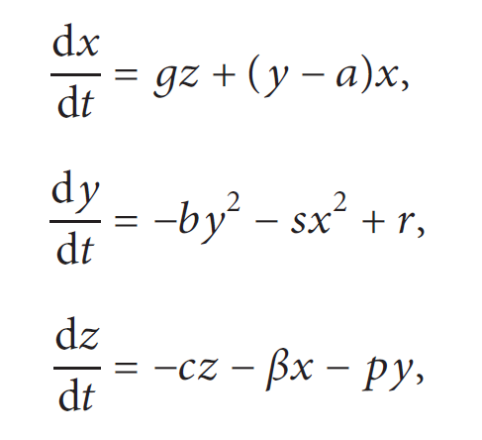
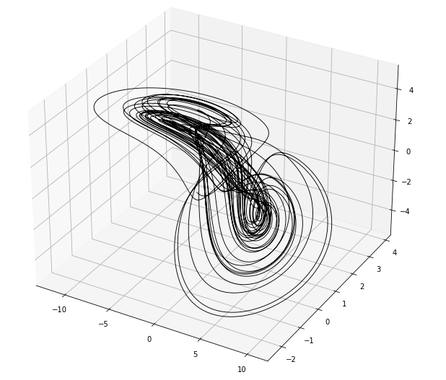
Other systems – Financial
The HAVOK analysis has been performed on a chaotic model of a financial system proposed by Huang and Li.
x(t) = interest rate
y(t) = investment demand
z(t) = price index
a = 0.3 b = 0.02 c = 1 r = 1
s = 0.1 p = 0.05 g = 1.2 β = 1

Slide 31
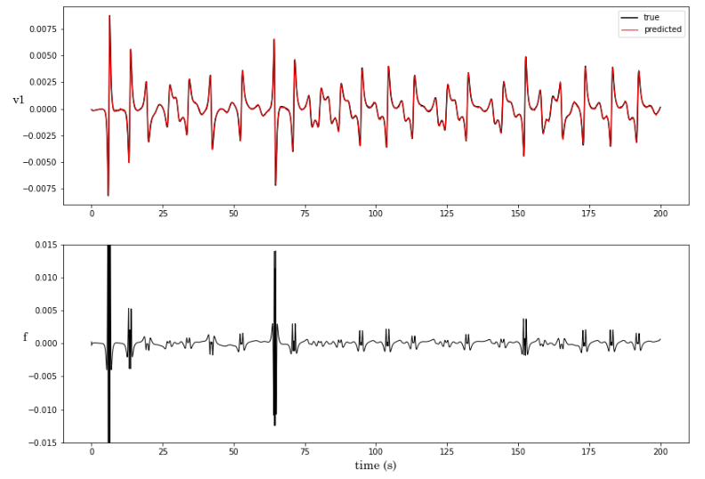
Other systems – Financial system

Slide 32
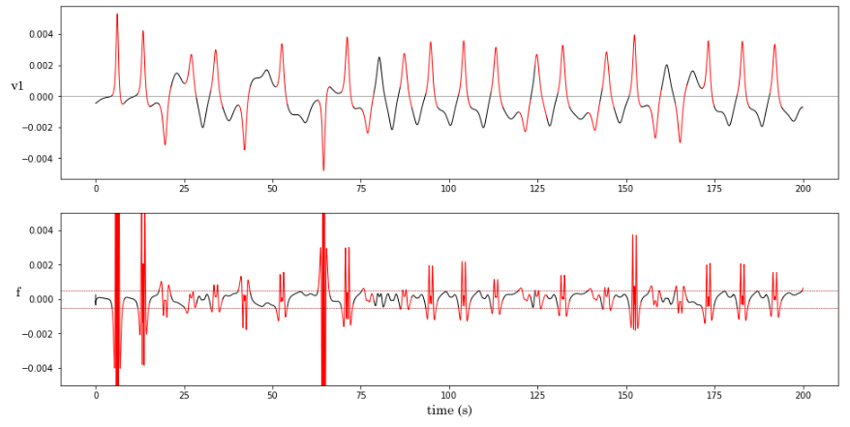
Other systems – Financial system

Slide 33
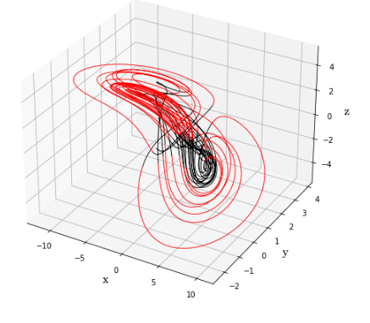
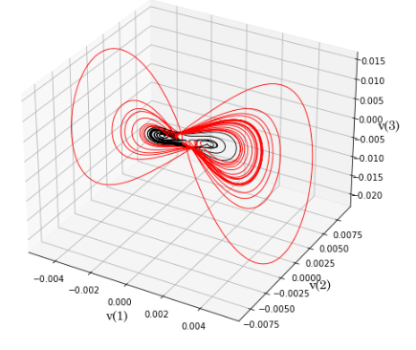
Other systems – Financial system
Real attractor
Embedded attractor

Slide 34

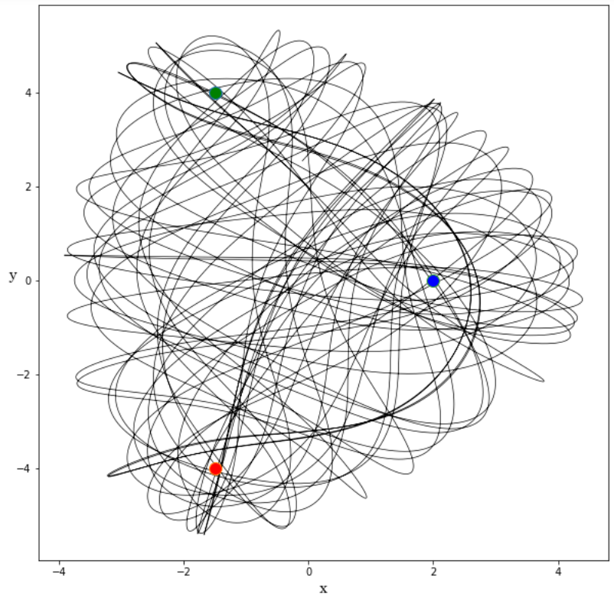
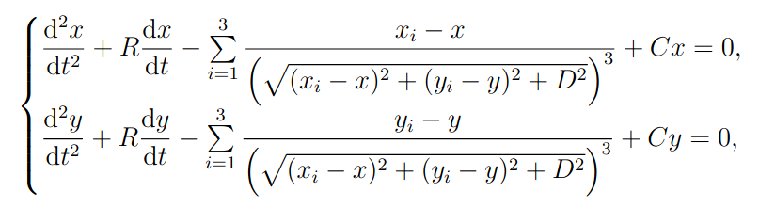

Other systems – Magnetic Pendulum
Does HAVOK work for more complex chaotic systems?
Is it able to reconstruct a dynamic based on three lobes?
Pendulum which oscillates above three magnets exerting an attractive force on it.
R = 0 air resistance factor
C = 0.03 gravity factor
D = 1 pendulum – plane distance

Slide 35
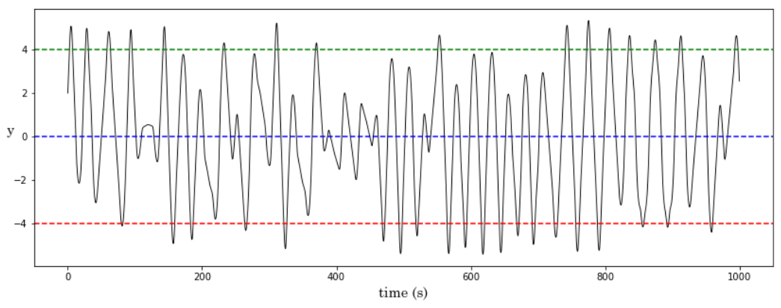
Other systems – Magnetic Pendulum
The time series is obtained by taking the Y coordinate.
The states of the system are not easily defined, making predictions appear difficult.

Slide 36
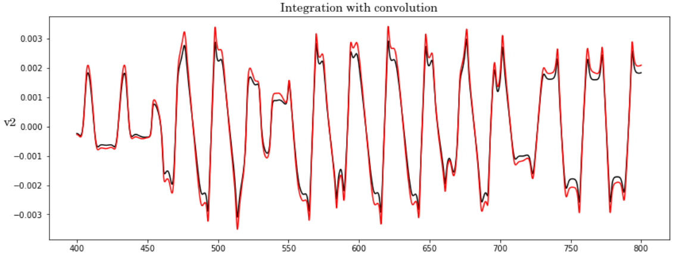
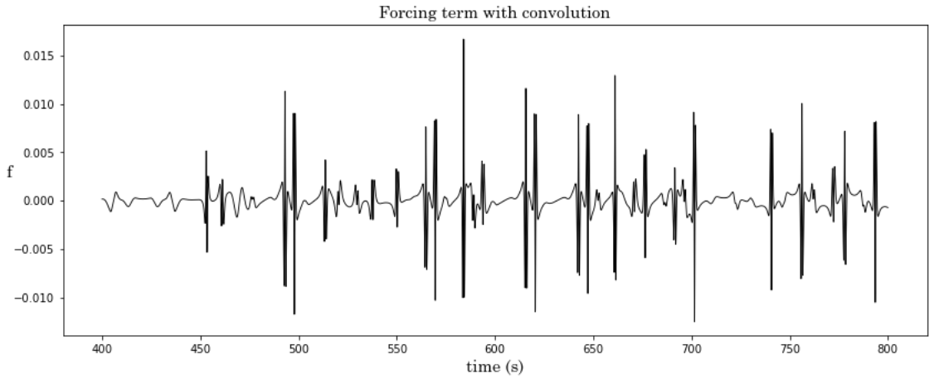
Other systems – Magnetic Pendulum
l = 100
dt = 0.001
r= 7

Slide 37
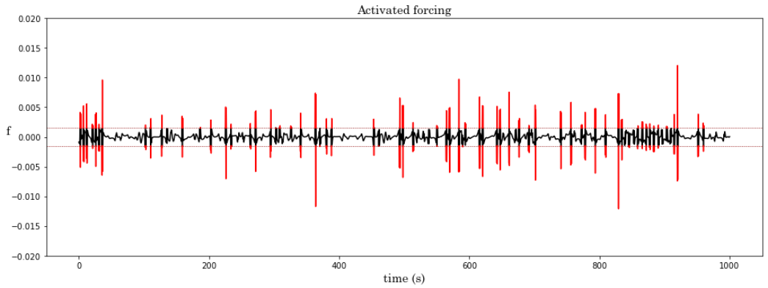
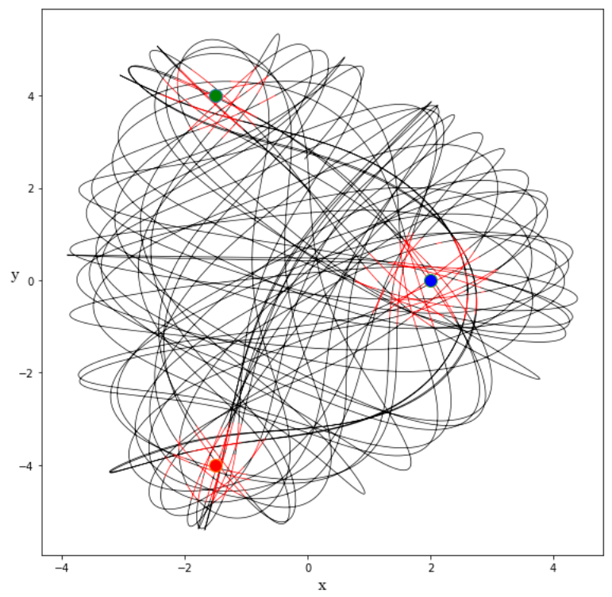
Other systems – Magnetic Pendulum
The forcing indeed isolates the nonlinear components of the system

Slide 38
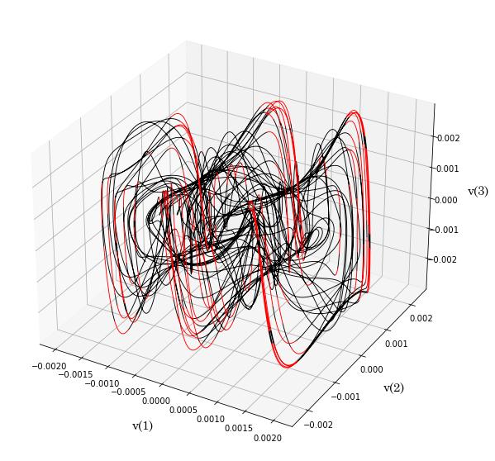
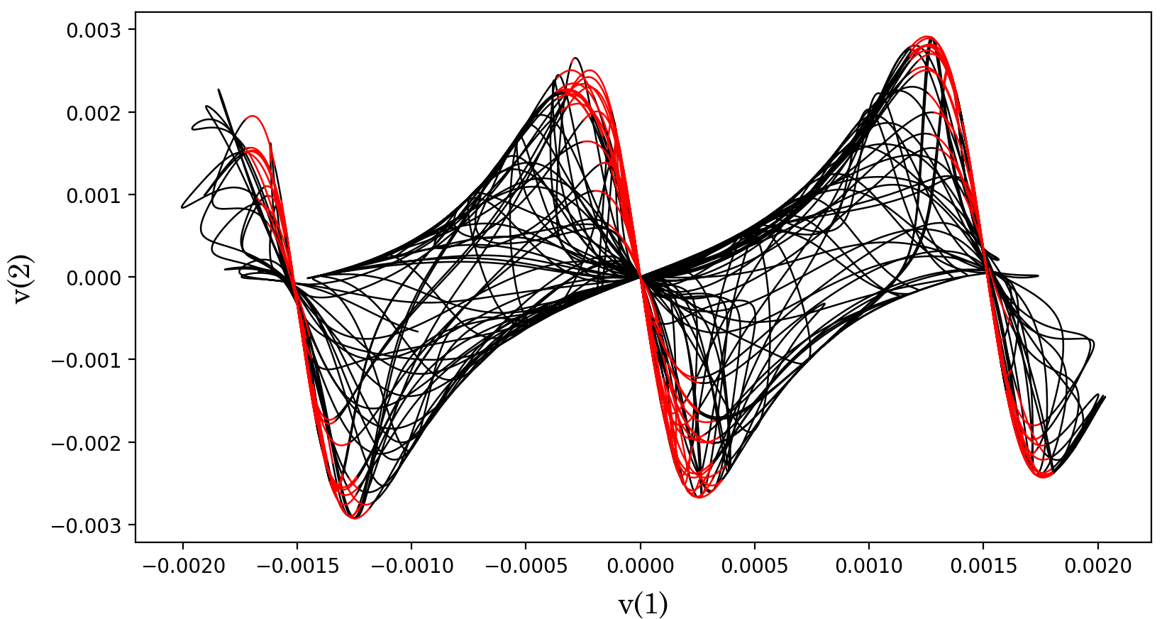

Other systems – Magnetic Pendulum
Embedded attractor
Projection on the x-z plane

Slide 39
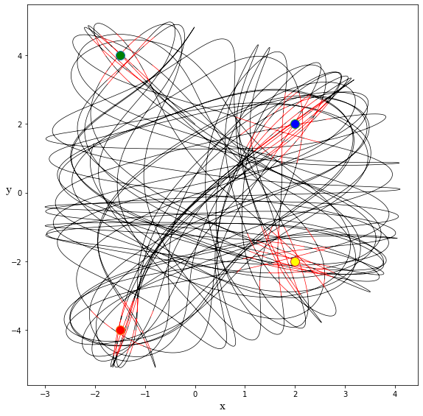
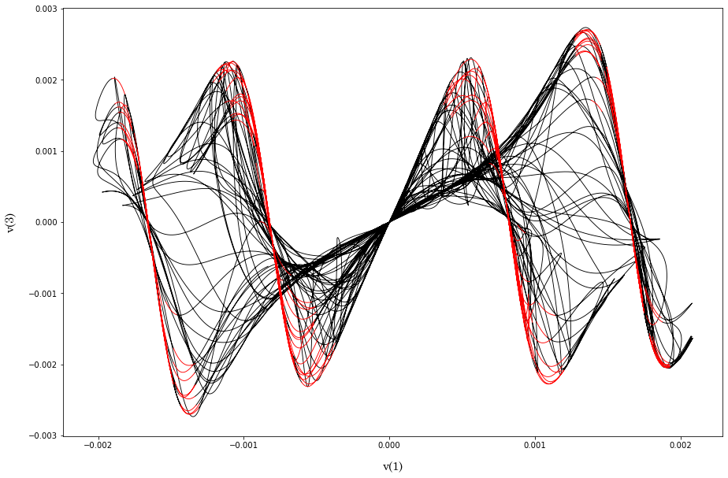
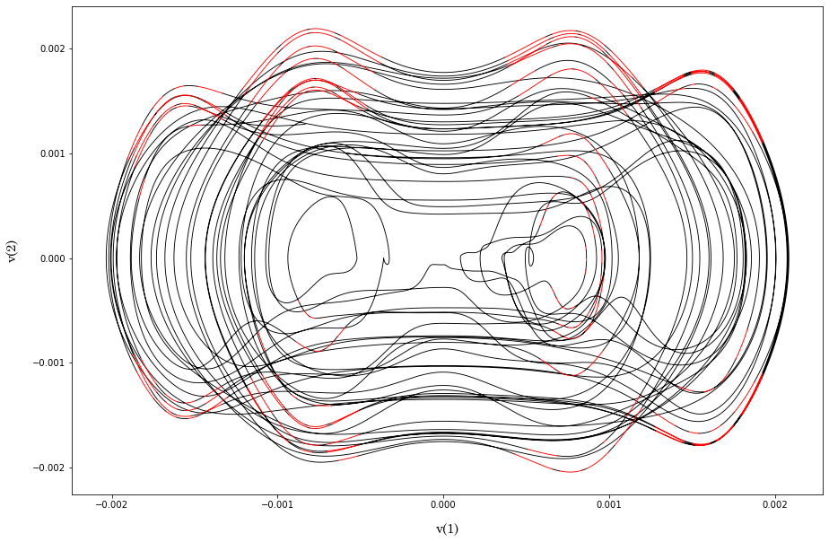
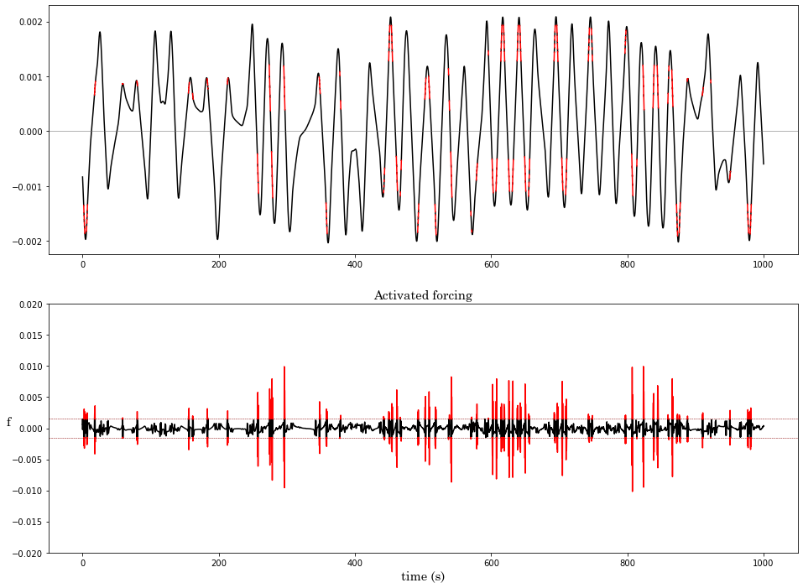
Other systems – Magnetic Pendulum

Slide 40

Open questions
Rescaling problem on the convolutional prediction:
If the sizes of the train and the test are different, the prediction needs to be rescaled.

Slide 41

Open questions
Rescaling problem on the convolutional prediction:
This can create problems when setting the threshold.

Slide 42

Open questions
SVD on the test set vs convolution
When looking for the forcing term, a straightforward application of an SVD to the test set gives worse results compared to the convolution procedure.

Slide 43
Open questions
SVD on the test set vs convolution
A small difference in the forcing term creates divergences in the long run.

Slide 44

Conclusions

Slide 45
Backup slides

Slide 46

Other systems

Slide 47



Other system – Rossler
Another simple example of chaotic model is the Rossler attractor.
a = 0.31 b = 0.1 c = 14

Slide 48



Other system–Rossler

Slide 49

Other system–Rossler

Slide 50


Other system–Rossler

